Slide 1
Project Chiron Interface – ROS Test Controller Winter 2018 Midterm Progress Report
Marie Bomber
Aaron Leondar
Hadi Rahal-Arabi

Slide 2
Project Overiew
Specific Use case
Project Chiron
General Use case
ROS Test Controller

Slide 3
Individual Responsibilities
Marie
Filesystem and Project Management
Now ROS
Aaron
ROS Control
Now Bootstrap/CSS
Hadi
Originally interface
Now NodeJS/Connection

Slide 4
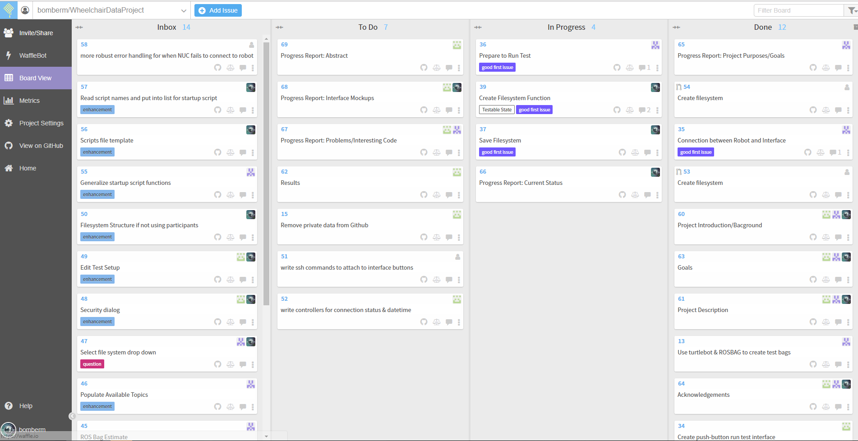
High Level Look

Slide 5
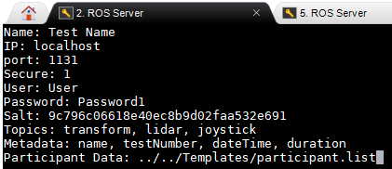
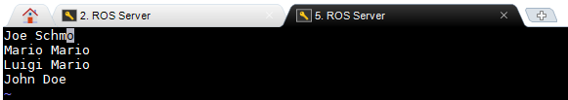
Test Templates
Participant List
Test Template

Slide 6
Project Chiron Interface Winter 2018 Midterm Progress Report
Marie Bomber
Aaron Leondar
Hadi Rahal-Arabi

Slide 7
Start of Development (Weeks 1-3)
Main problem: Re-tooling design document/requirements due to pre-winter break meeting
Expanded scope. Not just for Chiron anymore
Meant to be more of a general use case
Changed from web-based application to desktop interface

Slide 8
Start of Development (Weeks 1-3)
Main problem: Re-tooling design document/requirements due to pre-winter break meeting
Implement a method to create and save test parameters for easier access later
Method to export test data after recording

Slide 9
First Big Roadblock (Weeks 4-5)
Main problem: Running ROS commands using Python code is much harder than simply entering the commands themselves
Python also dislikes using ssh to connect, preferring to use ftp
When the interface ssh’s into the network given, it doesn’t have a ROS source, causing no ROS commands to work

Slide 10

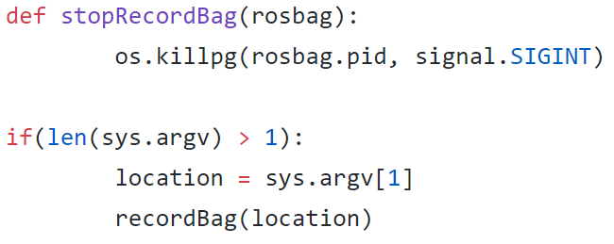
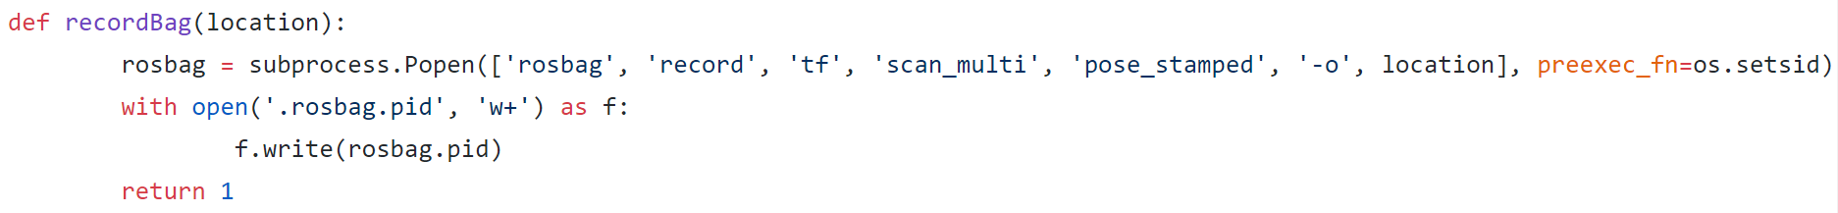
First Big Roadblock (Weeks 4-5)
Main problem: Running ROS commands using Python code is much harder than simply entering the commands themselves

Slide 11
Recovery (Weeks 5-6+)
Main Problem: Python is not a great language to implement the kind of interface that is needed, so needs to be re-implemented in NodeJS
Hadi has more information on that

Slide 12
Project Chiron Interface – ROS Test Controller Winter 2018 Midterm Progress Report
Marie Bomber
Aaron Leondar
Hadi Rahal-Arabi

Slide 13
Original Attempt
Python
Ssh connection emulation
No environment variables
Structured as singular app that sits on remote machine

Slide 14
Shift to API Architecture
A set of interconnected microservices instead of an application
NodeJS
Express
Express-handlebars
Exec

